Slide 1
Determining a Good Location to Build a New Nightclub Business in New York City
By: Thomas James
Coursera/IBM data Science Capstone Project
3/12/2021

Slide 2
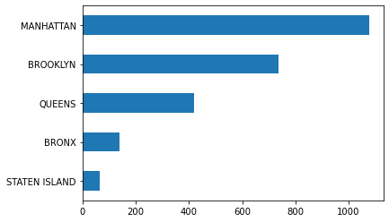
Initial Data & Bar Graph Analysis
df.shape → (2440, 7)
Bar graph →

Slide 3
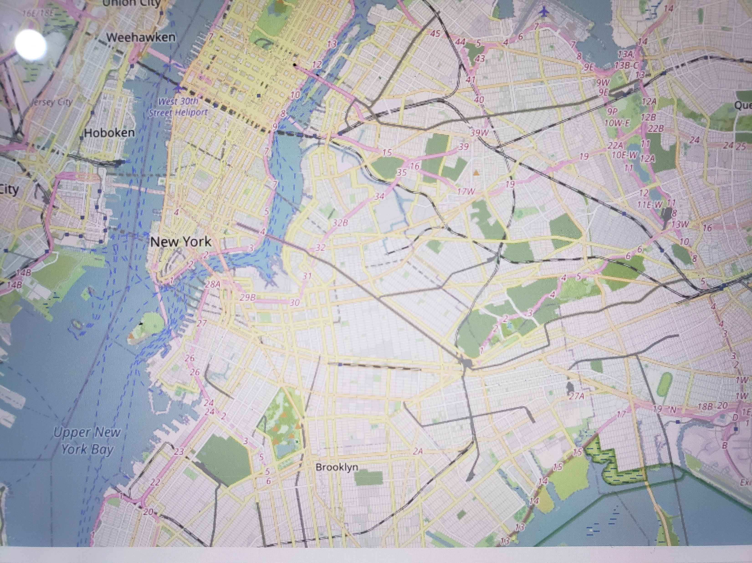

Heat Map(
Heat Map →

